Slide 1
XML

Slide 2
XML
XML
DOCTYPE: Document Type Définition (DTD)
XML Scheme
DOM
Tree-based APIs – DOM
SAX
Event-based APIs – SAX
XML Parsing
Example in Java XML Parsers
JAXP 1.3: Java API for XML Parsing (comes with JDK)
Xerces: software that reads XML doc and do something with it

Slide 3
What is XML?
XML is:
XML is a language for creating other languages!
meta language that defines other languages (XSSLT)
XML lets you define schemas for tag-based languages (“markup language”)
XML allows you to extend any existing language (schema) with your own tags (“eXtensible”)
Examples of XML schemas
Financial transactions (stock transactions)
business documents (purchase order, invoice)
remote procedure calls (SOAP)
configuration files (security, server properties)
Italian Leather Store

Slide 4
XML
The World Wide Web Consortium (W3C) formed an XML working group in 1996 with these design goals:
XML shall be straightforwardly usable over the Internet
XML shall support a wide variety of applications
It shall be easy to write programs which process XML documents
XML shall be compatible with SGML (Standard Generalized Markup Language [ISO 8879])
The number of optional features in XML is to be kept to the absolute minimum, ideally zero.
XML documents should be human-legible and reasonably clear.
The XML design should be prepared quickly.
The design of XML shall be formal and concise (http://www.w3.org/TR/REC-xml/)
XML documents shall be easy to create.

Slide 5
Application & XML Processor
Definition: A software module called an XML processor is used to read XML documents and provide access to their content and structure
Example Xerces 2.9.1
Build your own using JAXP/DOM
Definition: It is assumed that an XML processor is doing its work on behalf of another module, called the application

Slide 6
XML
When
XML 1.0 became a standard (W3C recommendation) on 10 February 1998
XML 1.1 became a standard (W3C recommendation) on 4 February 2004
XML Document
[Definition: A data object is an XML document if it is well-formed, as defined in this specification. In addition, the XML document is valid if it meets certain further constraints.]
Each XML document has both a logical and a physical structure.
Physically, the document is composed of units called entities.
An entity may refer to other entities to cause their inclusion in the document.
A document begins in a "root" or document entity.
Logically, the document is composed of declarations, elements, comments, character references, and processing instructions, all of which are indicated in the document by explicit markup

Slide 7
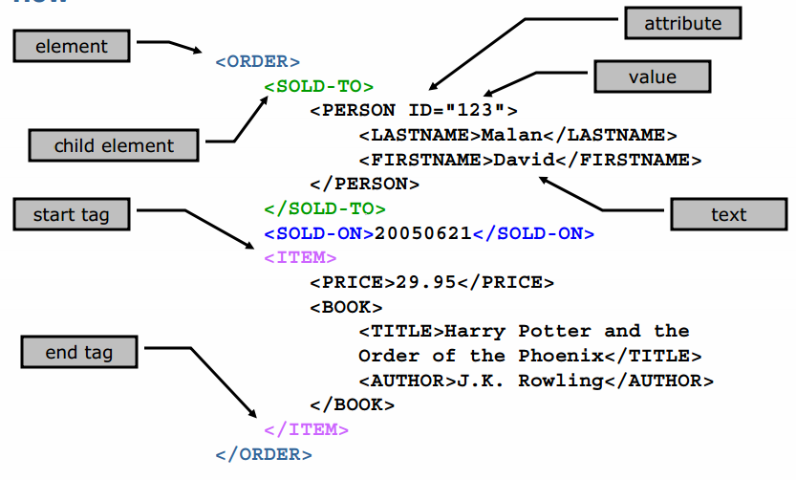

Slide 8
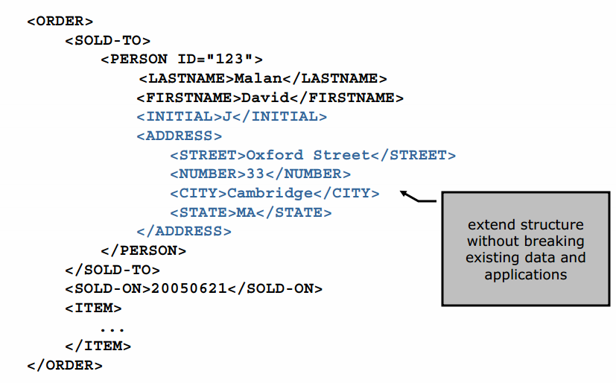

Slide 9
Well-Formed XML
Well-Formed XML Documents: adheres to the XML specifications
Correct syntax
One root element
Start-tag must have an end-tag
Respect parent child relationship
Child elements are unique within the a parent element
“Well formed XML is XML that has all tags closed in the proper order and, if it has a declaration, it has it first thing in the file with the proper attributes.”
The syntax rules:
XML documents must have a root element
XML elements must have a closing tag
XML tags are case sensitive
XML elements must be properly nested
XML attribute values must be quoted

Slide 10
Valid XML Document
A "Valid" XML document must be:
Well Formed and
Conform to a specified Document Type Definition (DTD)
Rules that defines legal elements and attributes for XML documents are often called: document definitions, or document schemas.

Slide 11
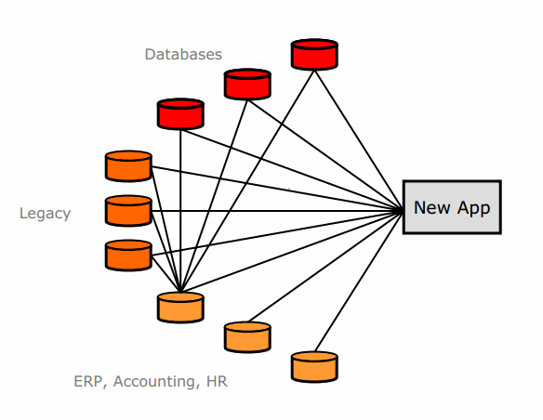
Application Integration

Slide 12
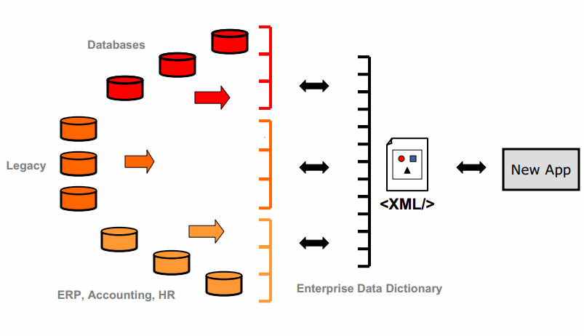
Application Integration

Slide 13
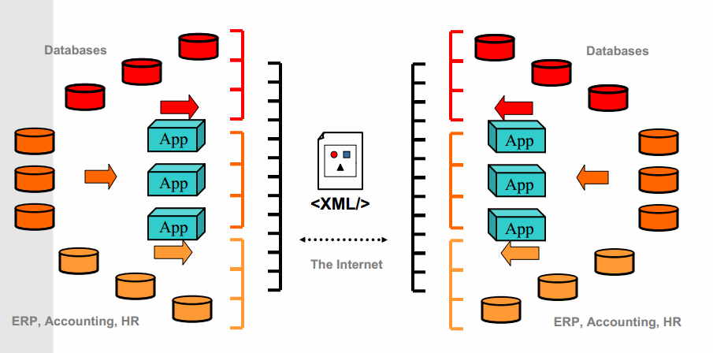
Application Integration

Slide 14
Platform-Independent Services
Web Services provide a new way to expose functionality
use XML and XML data types for transport
work with any platform
provide a bridge to existing business services
XML Enable Platform Independent Services

Slide 15
XML
Introduction to XML

Slide 16
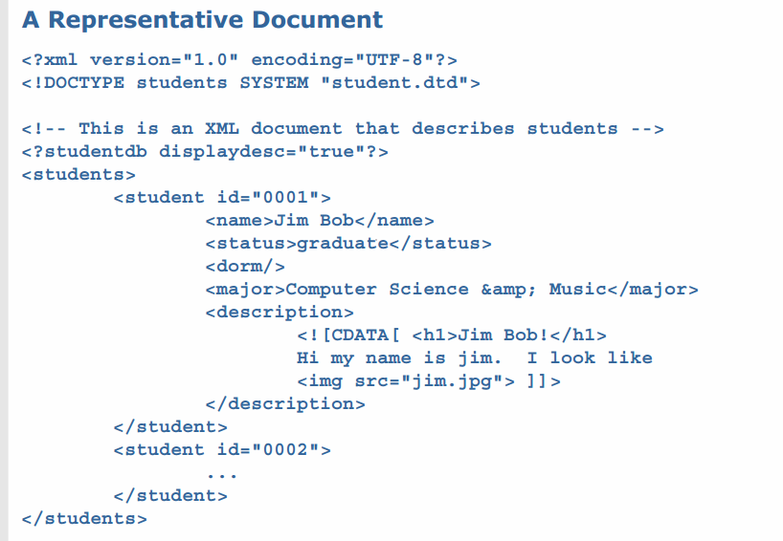
XML Documents
CDATA means, Character Data. CDATA is defined as blocks of text that are not parsed by the parser, but are otherwise recognized as markup

Slide 17
XML 1.1
XML Declaration
<?xml version="1.0" encoding="UTF-8"?>
Optional
Must appear at the very top of an XML document
Used to indicate the version of the specification to which the document conforms (and whether the document is “standalone”)
Used to indicate the character encoding of the document
UTF-8
UTF-8 is a variable-width encoding that can represent every character in the Unicode character set. It was designed for backward compatibility with ASCII
The first 128 characters of Unicode, which correspond one-to-one with ASCII
UTF-16
iso-8859-1

Slide 18
XML 1.1: DOCTYPE
DOCTYPE
<!DOCTYPE students SYSTEM "students.dtd">
Associate an XML document with its definition
Can refer to an external DTD file or
include some DTD information within the tag itself
Well formed and Valid XML Document
An XML document with correct syntax is called "Well Formed".
An XML document validated against a DTD is "Well Formed" and "Valid".
The purpose of a DTD is to define the structure of an XML document.
It defines the structure with a list of legal elements

Slide 19
XML 1.1: DTD
DOCTYPE: Document Type Definition (DTD)
<?xml version="1.0" encoding="UTF-8"?> <!DOCTYPE note SYSTEM "Note.dtd"> <note> <to>Tom</to> <from>Jane</from> <heading>Reminder</heading> <body>Don't forget my book!</body> </note>
external DTD file
Contents of Note.dtd:
<!DOCTYPE note [ <!ELEMENT note (to,from,heading,body)> <!ELEMENT to (#PCDATA)> <!ELEMENT from (#PCDATA)> <!ELEMENT heading (#PCDATA)> <!ELEMENT body (#PCDATA)> ]>

Slide 20
XML 1.1: DTD
The DTD above is interpreted like this:
!DOCTYPE note defines that the root element of the document is note
!ELEMENT note defines that the note element contains four elements: "to, from, heading, body"
!ELEMENT to defines the to element to be of type "#PCDATA"
!ELEMENT from defines the from element to be of type "#PCDATA"
!ELEMENT heading defines the heading element to be of type "#PCDATA"
!ELEMENT body defines the body element to be of type "#PCDATA"
#PCDATA means parse-able text data (Parsed Character Data):
external DTD file
Contents of Note.dtd:
<!DOCTYPE note [ <!ELEMENT note (to,from,heading,body)> <!ELEMENT to (#PCDATA)> <!ELEMENT from (#PCDATA)> <!ELEMENT heading (#PCDATA)> <!ELEMENT body (#PCDATA)> ]>

Slide 21
XML 1.1: DTD
A DOCTYPE declaration can also be used to define special characters and character strings, used in the document:
<?xml version="1.0" encoding="UTF-8"?> <!DOCTYPE note [ <!ENTITY nbsp "&#xA0;"> <!ENTITY writer "Writer: Donald Duck."> <!ENTITY copyright "Copyright: W3Schools."> ]> <note> <to>Tom</to> <from>Jane</from> <heading>Reminder</heading> <body>Don't forget my book!</body> <footer>&writer;&nbsp;&copyright;</footer> </note>
An entity has three parts: an ampersand (&), an entity name, and a semicolon (;).
&#x00A9; is ©

Slide 22
XML 1.1: DTD
Why Use a DTD?
With a DTD, your XML files can carry a description of its own format.
With a DTD, independent groups of people can agree on a standard for interchanging data.
With a DTD, you can verify that the data you receive from the outside world is valid.
DTD: cannot specify data types , use XML Scheme to overcome this limitation

Slide 23
XML Scheme
A set of rules that a document (XML) need to follow
<xsd: element name=“quantity” type=“xsd: integer” />
XML Scheme is written in XML
XML Schemas are much more powerful than DTDs.
XML Schemas Support Data Types
You can define your own data type (user defined data types)

Slide 24
XML 1.1: Scheme
XML Scheme file note.xsd
<?xml version="1.0"?> <xs:schema xmlns:xs="http://www.w3.org/2001/XMLSchema" targetNamespace="http://www.w3schools.com" xmlns="http://www.w3schools.com" elementFormDefault="qualified"> <xs:element name="note"> <xs:complexType> <xs:sequence> <xs:element name="to" type="xs:string"/> <xs:element name="from" type="xs:string"/> <xs:element name="heading" type="xs:string"/> <xs:element name="body" type="xs:string"/> </xs:sequence> </xs:complexType> </xs:element> </xs:schema>>
An XML Scheme
<?xml version="1.0" ?>
<note xmlns="http://www.w3schools.com" xmlns:xsi="http://www.w3.org/2001/XMLSchema-instance" xsi:schemaLocation="http://www.w3schools.com/note.xsd">
<to>Tom</to> <from>Jane</from> <heading>Reminder</heading> <body>Don't forget my book!</body> </note>
The note element is a complex type because it contains other elements.
The other elements (to, from, heading, body) are simple types because they do not contain other elements

Slide 25
XML 1.1: Elements
Element
<name>Mark James</name>
Main structure in an XML document
Only one root element allowed
Start Tag
Allows specification of zero or more attributes <student id="0001" ...>
End Tag
Must match name, case, and nesting level of start tag
</student>
Name must start with letter or underscore and can contain only letters, numbers, hyphens, periods, and underscores

Slide 26
XML 1.1: Elements
Element Content
<student>
<status>...</status>
</student>
Parsed Character Data (aka PCDATA, aka Text)
PCDATA is text that is parsed char by char
<name>Jim Bob</name>
Mixed Content
<name>Jim <initial>J</initial> Bob</name>
No Content
Can be useful like line breaks or empty data elements (no value)
<dorm/>
No data associated with students dorm but we need the element could be mapped to a NULL value in DB for example

Slide 27
XML 1.1: Attributes
Attributes
Describe elements further and can mean anything
<student id=“3598">
Name
Must start with letter or underscore and can contain only letters, numbers, hyphens, periods, and underscores
Value
Can be of several types, but is almost always a string
Must be quoted
title="Lecture 2"
Nested
match='item="baseball bat"'
Cannot contain < or & (by itself)

Slide 28
Discussion: Elements vs. Attributes
When to use elements and not attributes
If Data is extensible (can refine further)
Coding implications
<student id=“12345” name=“Joe Smith”>
</student>
Vs. ?????????
<student id=“12345”>
<name>Joe smith”</name>
</student>

Slide 29
XML 1.1: PCDATA
#PCDATA - parse-able text data.
Called ENTITIES that have predetermined meaning
Jim Bob
Text that appears as the content of an element
Can reference entities
Cannot contain < or & (by itself)

Slide 30
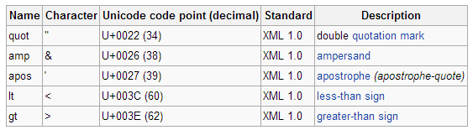
XML 1.1: Entities
Entities
Five pre-defined entities representing special characters :
&amp; &lt; &gt; &apos; &quot;
Used to “escape” content or include content that is hard to enter or repeated frequently

Slide 31
XML 1.1: Entities
Character entities
can refer to a single character by unicode number
e.g., &#x00A9; is ©
Must be declared to be legal (in DTD)
<!ENTITY nbsp "&#160;">
&nbsp is not XML (its html) and present coding issues for software like XSSLT which generates HTML form XML

Slide 32
XML 1.1: CDATA
CDATA
<![CDATA[ <h1>Jim Bob!</h1> ... ]]>
Text that is NOT Parsed (as is)
Data within is not checked for subelements, entities, etc.
Allows you to include badly formed markup or character data that would cause a problem during parsing
Examples
Including HTML tags in an XML document
In HMTL
Javascript code is in an hmtl document to tell the parser/browser not to parse/render it.

Slide 33
XML 1.1: Comments
Comments
<!-- This is ... -->
Can include any text inside a comment to make it easier for human readers to understand your document
Generally not available to applications reading the document
Always begin with <!-- and end with -->
Cannot contain --

Slide 34
XML 1.1: Processing Instructions (PI)
Processing Instructions (PI)
<?studentdb displaydesc="true"?>
“Sticky notes” to applications processing an XML document that explain how to handle content
The target portion (e.g., studentdb) of a PI indicates the application that is to process this instruction;
cannot start with “xml”
The remainder of the PI can be any text that gives instructions to the application
Examples
Instructions to an application to display different versions of an image
Instructions to an application to suppress display of certain content
Configuration Parameters

Slide 35
XML docs are Well-Formed
A well-formed XML document is a document that conforms to the XML syntax rules, like:
it must begin with the XML declaration
it must have one unique root element
start-tags must have matching end-tags
elements are case sensitive
all elements must be closed
all elements must be properly nested
all attribute values must be quoted
entities must be used for special characters

Slide 36
XML docs are Valid
Valid XML Documents: Conforms to rules in DTD or XML Scheme
XML documents can have a reference to a DTD or to an XML Schema

Slide 37
discussion
1
2
3
Is this valid XML document
<foo>
</foo>
<bar>
</bar>
Is this valid XML document
<foo>
<bar>
</foo>
</bar>
Is this valid XML document
<foo>
</bar>
</foo>

Slide 38
Tree based vs. event based
XML 1.1 Parsers

Slide 39
Events vs. Trees
There are two major types of XML APIs:
Tree-based APIs
These map an XML document into an internal tree structure, then allow an application to navigate that tree.
The Document Object Model (DOM) working group at the World-Wide Web Consortium (W3C) maintains a recommended tree-based API for XML and HTML documents, and there are many such APIs from other sources.
Event-based APIs
An event-based API, on the other hand, reports parsing events (such as the start and end of elements) directly to the application through callbacks,
Does not build an internal tree.
The application implements handlers to deal with the different events, much like handling events in a graphical user interface.
SAX is the best known example of such an API.

Slide 40
Tree-based APIs - DOM
They normally put a great strain on system resources, especially if the document is large
Many applications need to build their own strongly typed data structures rather than using a generic tree corresponding to an XML document
in-memory parse tree
DOM:
Presents an XML document as a tree-structure
The XML DOM parser converts XML into an XML DOM object that can be accessed with JavaScript, Java, .Net, etc.

Slide 41
Event-based APIs SAX
Reports parsing events (such as the start and end of elements) directly to the application through callbacks,
The application implements handlers to deal with the different events, much like handling events in a graphical user interface.
Does not build an internal tree.
Event-based API provides a simpler, lower-level access to an XML document:
you can parse documents much larger than your available system memory
SAX is the best known example of such an API

